Slide 1


CPSC 462 – Software Design
Sample Project Design and Source Code
Professor T. L. Bettens
Spring 2020

Slide 2
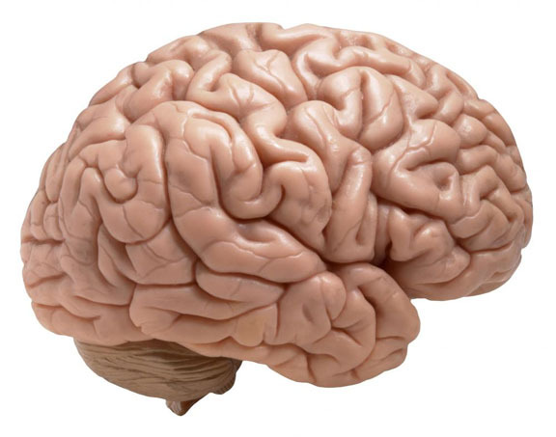
The most important thing you can learn in object-oriented analysis and design
is
skillful responsibility assignment

Slide 3
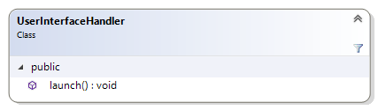
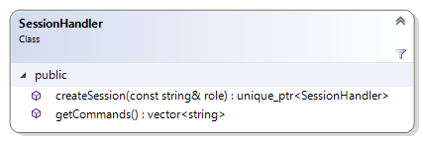
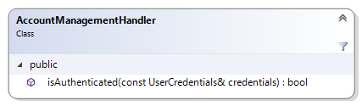
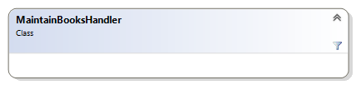
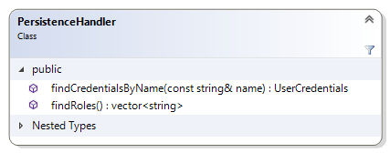
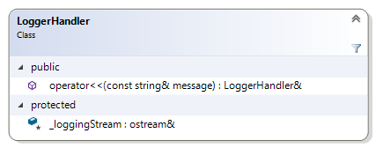
Layers & Layer Interfaces
UI Layer
Domain Layer
Technical Services

Slide 4
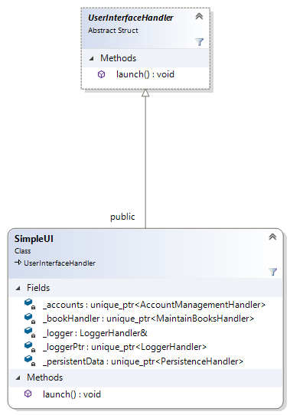
User Interface Layer
Interface to the UI Layer from main()
Realization (instance) of the UI Interface

Slide 5
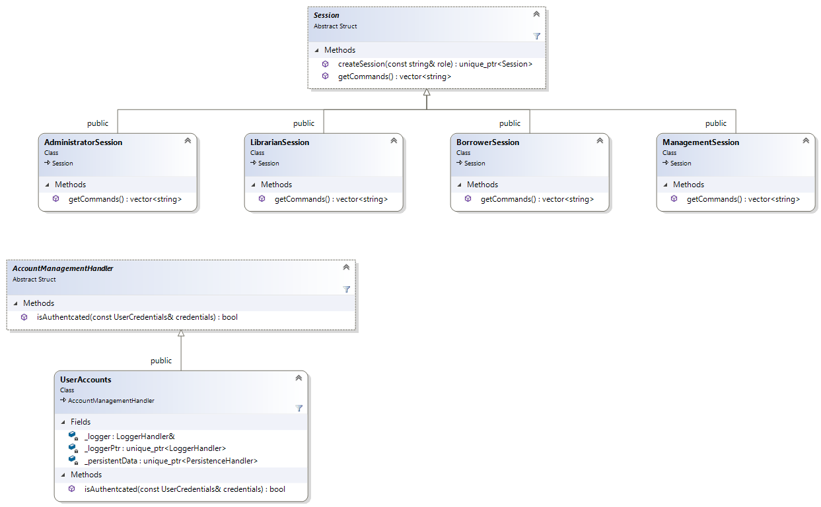
Domain Layer
Interface to the Domain Layer’s Sessions from main() and UI
Realizations (instances) of a Session
Interface to the Domain Layer’s Account Management from main() and UI
Realizations (instances) of an Account Manager

Slide 6
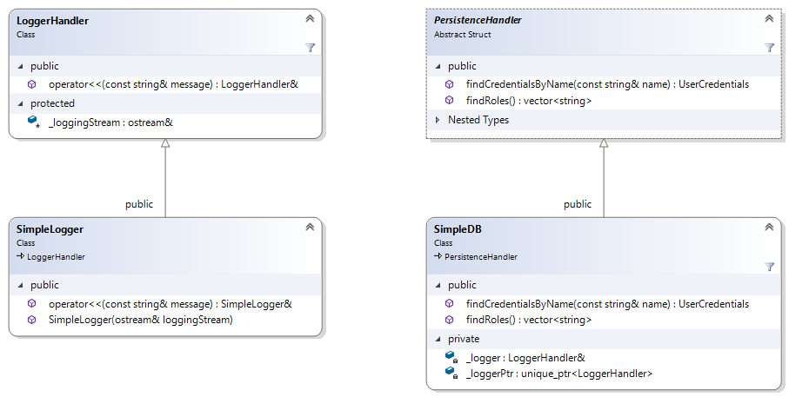
Technical Services Layer
Interfaces
Realizations

